Slide 1

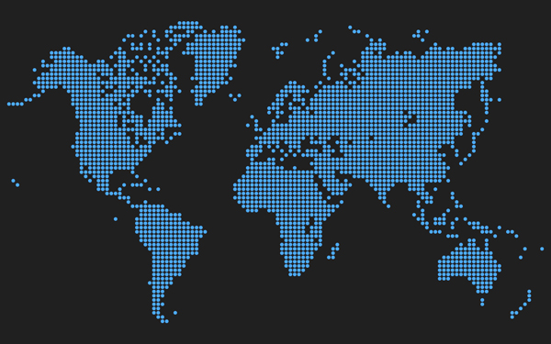

PR & SOCIAL MEDIA
Global Media & Technology Intellicast Series
Essential Strategic Intelligence for Today’s Media Ecosystem
Global Consumer Media Usage & Exposure Forecast 2015-19
3rd Edition
Report #2 of 3 in Series
Comprehensive Data & Analytics by Country, Silo, Media Sector, Platform & Social Generations
Country, Platform, Channel
4 Global Regions
15 Leading Countries
2 Major Sectors
11 Media Silos (New in 2015)
3 Digital Media Platforms
22 Digital Media Channels
8 Traditional Media Platforms
2 Demographic Breakout
Gender
Generations
  iGen
  Millennials
  Gen X
  Boomers
  Great Gen
15 Leading Markets
Australia
Brazil
Canada
China
France
Germany
India
Italy
Japan
Mexico
Russia
South Korea
Spain
United Kingdom
United States
Usage Definitions by Sector, Platform, Channel, Silo
Rankings by Region, Country, Sector
2009-14 Actuals
2015-19 Forecasts
PQ Media on LinkedIn
www.pqmedia.com
PQ Media on Twitter

Slide 2
  Global Consumer Media Usage & Exposure Forecast 2015
  Global

Slide 3
Total Global Media Usage & Exposure Rose 2.6% in 2014 to 45.0 Hours Per Week
Projected to Post 2% CAGR Gain to 49.7 Hours Per Week in 2019

Slide 4
Digital Represents 14.1% Share of Total Usage in 2014
Men Use Digital More than Women; I-Gen Highest Digital Users at Almost 22% Share
Total
Men
Women
i-Gen
Millennials
Gen-X
Boomers
Great Gen
Digital Usage
Traditional Usage

Slide 5
Consumers Use Television More than Any Other Media Silo at 24.6 Hours Per Week in 2014
Legacy Digital Media, Content Only Available on Digital Devices, Reached 2.4 HPW
Total Media Usage & Exposure by Media Silos in 2014
Legacy Internet & Mobile Media are specific to channels and sites that are exclusively digital, such as online search and mobile marketing apps
The digital brand extension of traditional media companies, such as videos placed on ESPN.com & ESPN Mobile, are included in the traditional media platform (e.g., TV).
Additionally, all forms of the media platform, including pure-play digital companies are included in that platform, such as Huffington Post in News & Information

Slide 6
Digital Global Media Usage & Exposure Rose 12% in 2014 to 6.3 Hours Per Week
Projected to Post 9.4% CAGR Gain to 9.9 Hours Per Week in 2019

Slide 7
Mobile Video Fastest Growing Digital Media Channel for Usage – Up 33% in 2014
e-Commerce Slowest Growing of 22 Digital Media Usage & Exposure Channels Tracked at 0%
Growth of Digital Media Channel Usage in 2014

Slide 8
Global Traditional Advertising & Marketing Revenues Rose 1.6% in 2014 to $739.0 Billion
Projected to Post 2.7% CAGR to $844.1 Billion in 2019

Slide 9
Global Economic Growth Has Been Sluggish, with Digital Usage Outpacing GDP by 10 Pct Pts
As Digital Device Penetration Reaches Saturation in Developed Nations, Difference 3 Pts in 2019

Slide 10
Japan Ranked First in Total Media Usage; China in Growth; South Korea in Digital Media Share
US Ranked Fifth in Usage, 11th in Growth, and Third in Digital Media Share
Total Media Usage & Exposure
2014 Usage & Exposure | 2014 vs. 2013 Growth | 2014 Share of Digital Media
Japan | China | South Korea
Germany | Russia | Australia
Canada | Brazil | United States
United Kingdom | India | United Kingdom
United States | South Korea | France
Source: PQ Media
US ranked 11th in growth

Slide 11
  Global Consumer Media Usage & Exposure Forecast 2015
  United States

Slide 12
Total US Media Usage & Exposure Rose 0.7% in 2014 to 64.7 Hours Per Week
Projected to Post 0.7% CAGR Gain to 67.0 Hours Per Week in 2019

Slide 13
Digital Represents 25.9% Share of Total Usage in 2014
Men Use Digital More than Women; I-Gen Highest Digital Users at Almost 40% Share
Total
Men
Women
i-Gen
Millennials
Gen-X
Boomers
Great Gen
Digital Usage
Traditional Usage

Slide 14
Consumers Use Television More than Any Other Media Silo at 32.5 Hours Per Week in 2014
Legacy Digital Media, Content Only Available on Digital Devices, Reached 5.8 HPW
Total Media Usage & Exposure by Media Silos in 2014
Legacy Internet & Mobile Media are specific to channels and sites that are exclusively digital, such as online search and mobile marketing apps
The digital brand extension of traditional media companies, such as videos placed on ESPN.com & ESPN Mobile, are included in the traditional media platform (e.g., TV).
Additionally, all forms of the media platform, including pure-play digital companies are included in that platform, such as Huffington Post in News & Information

Slide 15
Digital US Media Usage & Exposure Rose 9.6% in 2014 to 16.8 Hours Per Week
Projected to Post 7.3% CAGR Gain to 23.9 Hours Per Week in 2019

Slide 16
Mobile Audio Fastest Growing Digital Media Channel for Usage – Up 41% in 2014
PC Usage for Search & E-Mail and e-Commerce Fell As Consumers Switch to Mobile Devices
Growth of Digital Media Channel Usage in 2014

Slide 17
Traditional US Media Usage & Exposure Fell 2.1% in 2014 to 47.9 Hours Per Week
Projected to Post 2.1% CAGR Decline to 43.1 Hours Per Week in 2019

Slide 18
US Digital Media Usage & Exposure Outpaces GDP Growth by 3-5 Points
Overall and Traditional Media Usage Underperform Economic Growth by 2-6 Points

Slide 19

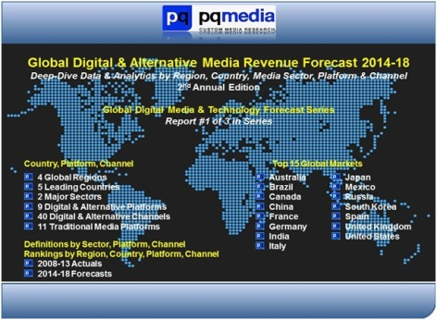
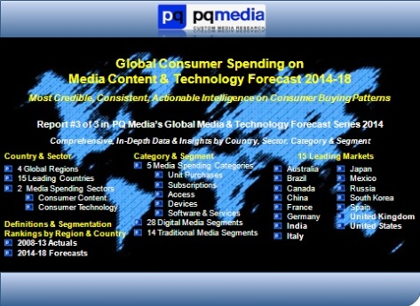
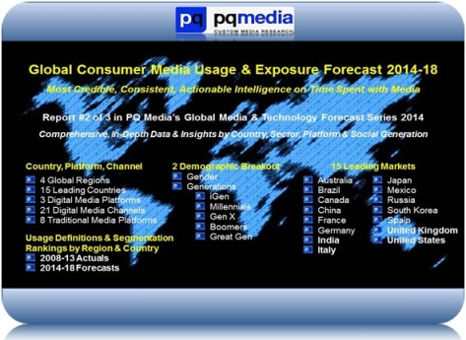
This is the second report of the three-part series in the PQ Media Global Media & Technology Forecast Intellicast Series. This series delivers the first holistic map of the media ecosystem. It is organized by country, medium, channel, device, generation and gender, covering more than 100 digital and traditional media channels and 15 leading global markets, including the US. The findings are comprehensive, data rich, and forms the foundation of essential media business intelligence. Click on any of the links below to visit PQ Media’s Research Report webpage and download the free executive summaries of last year’s reports The 2015 editions of the last report will be released later this year.
Global Digital & Alternative Media Revenue Forecast 2014-18.
Global Consumer Media Usage & Exposure Forecast 2014-18.
Global Consumer Spending on Media & Technology Forecast 2014-18.
Success in today’s fast-changing media economy requires timely, accurate and actionable strategic intelligence. Let PQ Media help your organization move towards a successful digital media future with a free, no-obligation situation review. To schedule your review, please contact Patrick Quinn at pquinn@pqmedia.com or Dr. Leo Kivijarv at lkivijarv@pqmedia.com or call 203-569-9449.

